Slide 1
基于MindSpore Quantum实现量子线路的中间测量和比特复用
李清钰
电子科技大学

Slide 2
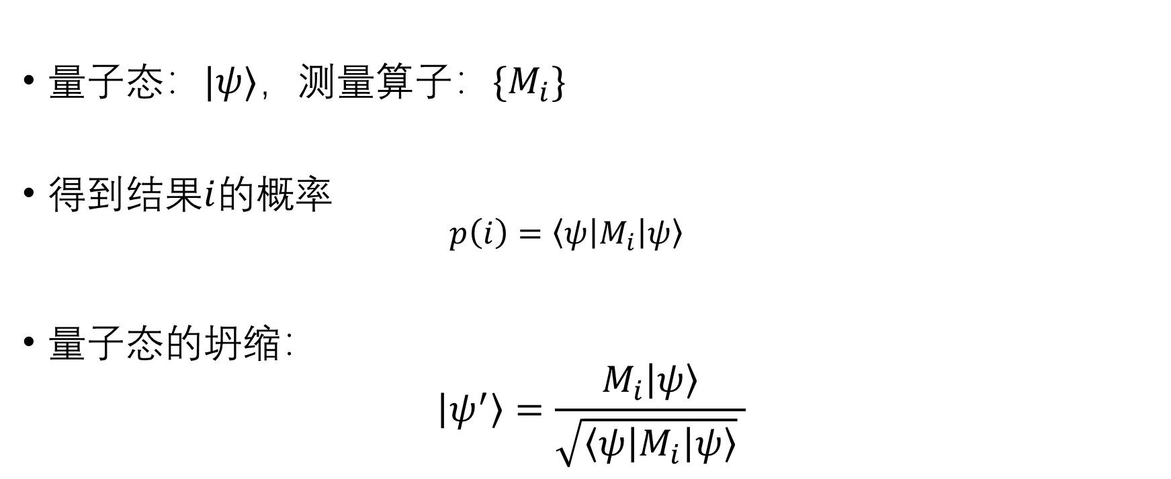
量子测量假设
量子态：$|ψ⟩$，测量算子：$\{M_{i}\}$
得到结果$i$的概率
$$p\left(i\right)=\left\langle ψ\left|M_{i}\right|ψ\right\rangle$$
量子态的坍缩：
$$\left|ψ^{′}\right\rangle =\frac{M_{i}\left|ψ\right\rangle }{\sqrt{\left\langle ψ\left|M_{i}\right|ψ\right\rangle } }$$

Slide 3
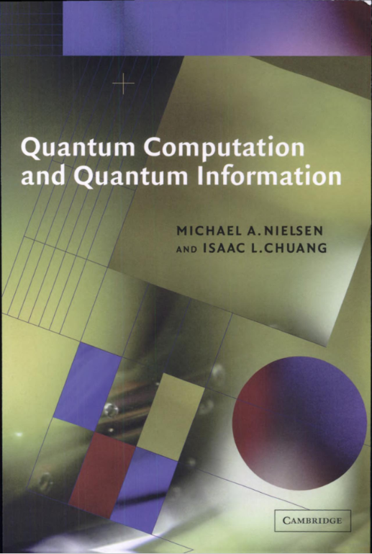
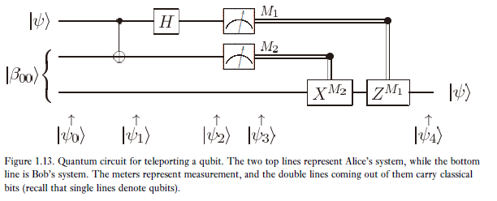
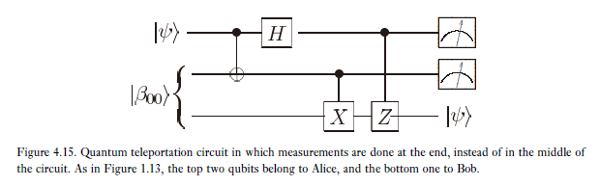
中间线路测量
中间电路测量是在电路末端之前执行的任何测量
延迟测量原理：

Slide 4
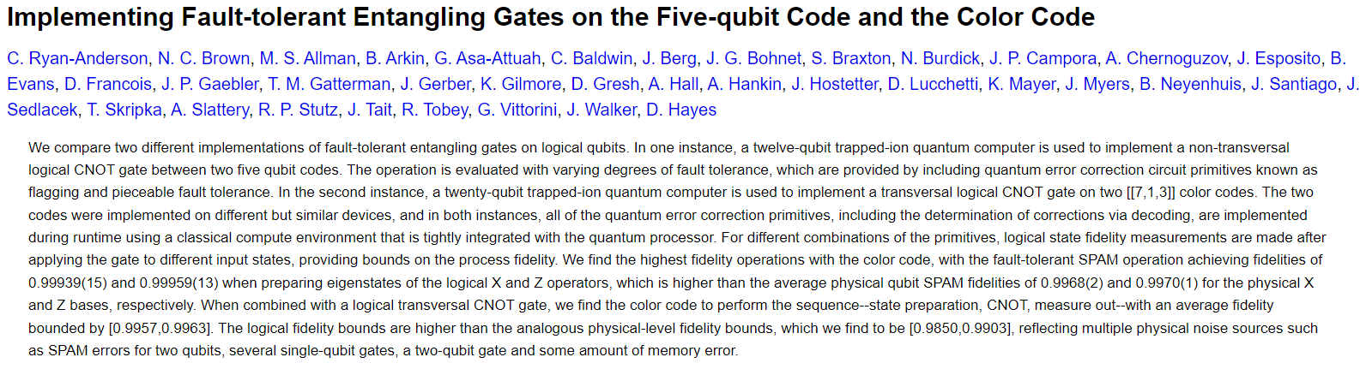
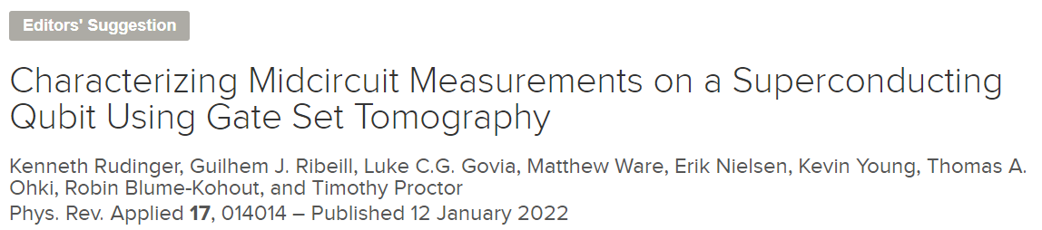
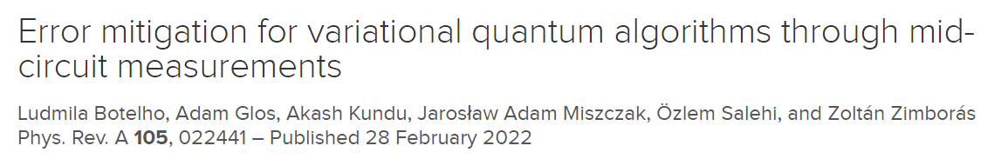
中间线路测量的应用
量子纠错

Slide 5
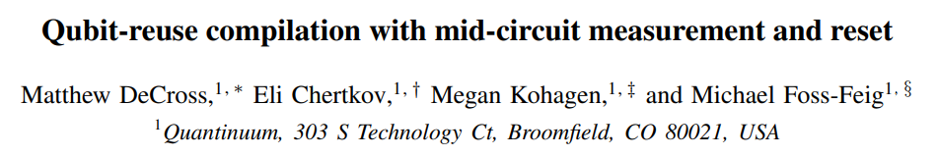
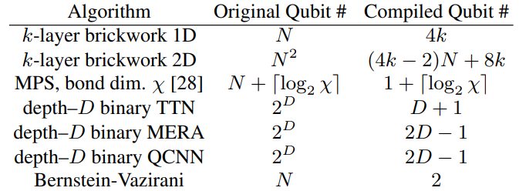
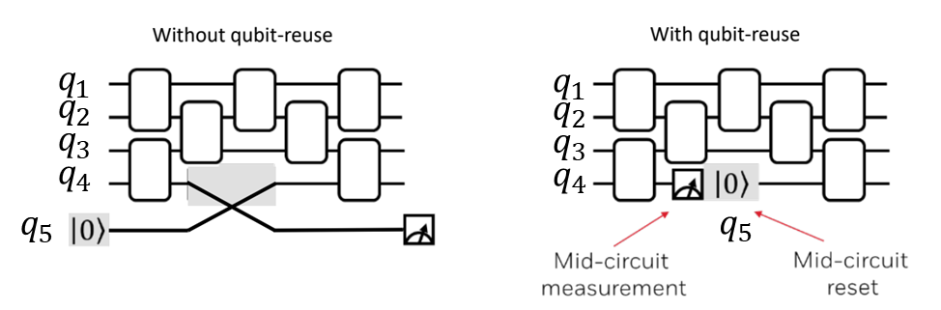
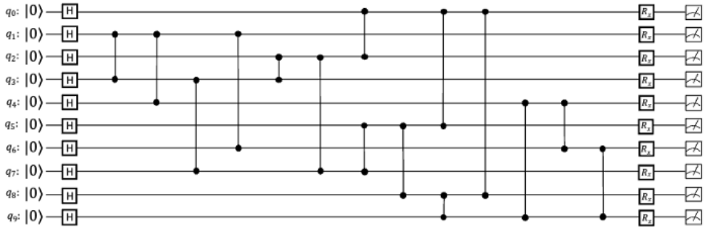
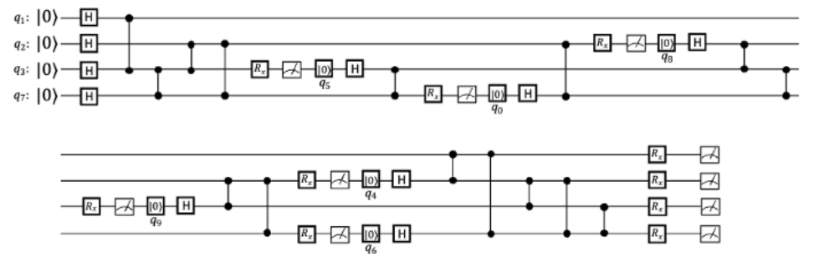

中间线路测量的应用
量子比特重用
量子线路的自动编译
80量子比特$⇒$20量子比特
Qubit reuse

Slide 6
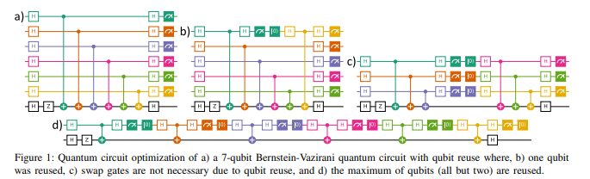

中间线路测量的应用
量子比特重用
量子线路的自动编译

Slide 7
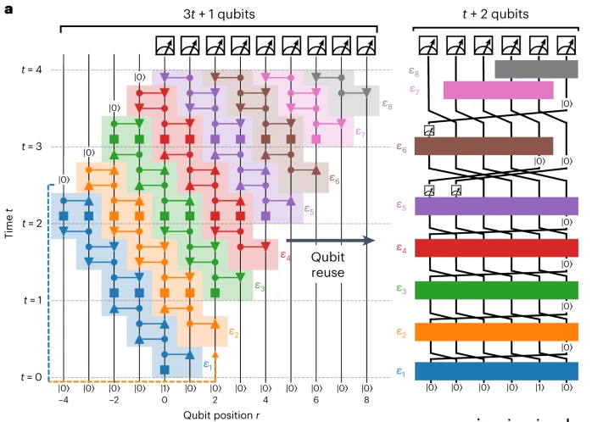
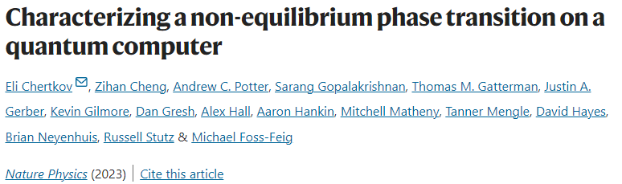
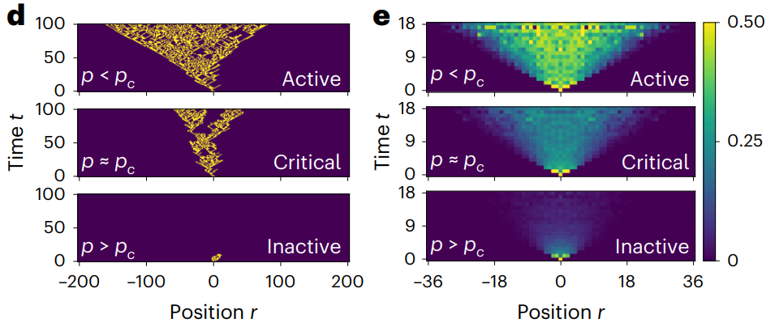

中间线路测量的应用
量子比特重用
t=18, 73位点72层线路$⇒$20 量子比特

Slide 8
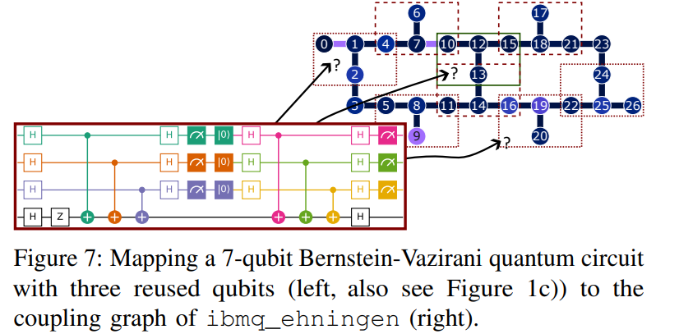
中间线路测量的应用
量子比特重用
Qubit mapping + Qubit reuse=?

Slide 9


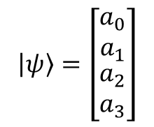
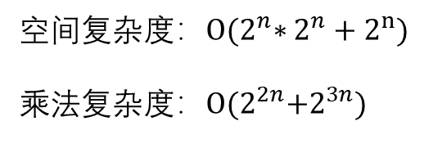

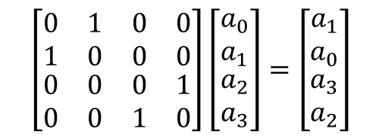



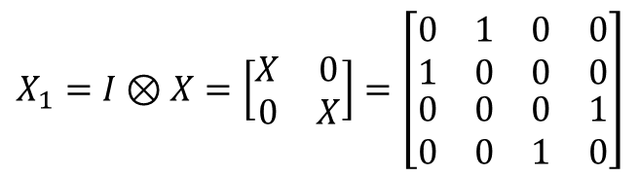


量子线路的模拟方法
$$\left|0\right\rangle =\left[\begin{aligned}1 \\ 0\end{aligned}\right]$$
$$\left|1\right\rangle =\left[\begin{aligned}0 \\ 1\end{aligned}\right]$$
$$\left|ψ\right\rangle =\left[\begin{aligned}α \\ β\end{aligned}\right]$$
$$\left|ψ\right\rangle =α\left|0\right\rangle +β|1⟩$$
$$\left|ψ\right\rangle =\left[\begin{matrix}a_{0} \\ a_{1} \\ \begin{aligned}a_{2} \\ a_{3}\end{aligned}\end{matrix}\right]$$
$$\left|ψ\right\rangle =a_{0}\left|00\right\rangle +a_{1}\left|01\right\rangle +a_{2}\left|10\right\rangle +a_{3}|11⟩$$
$$X=\left[\begin{matrix}0 & 1 \\ 1 & 0\end{matrix}\right]$$
$$Y=\left[\begin{matrix}0 & −i \\ i & 0\end{matrix}\right]$$
$$Z=\left[\begin{matrix}1 & 0 \\ 0 & −1\end{matrix}\right]$$
$$X_{1}=I⊗X=\left[\begin{matrix}X & 0 \\ 0 & X\end{matrix}\right]=\left[\begin{matrix}\begin{matrix}0 & 1 \\ 1 & 0\end{matrix} & \begin{matrix}0 & 0 \\ 0 & 0\end{matrix} \\ \begin{matrix}0 & 0 \\ 0 & 0\end{matrix} & \begin{matrix}0 & 1 \\ 1 & 0\end{matrix}\end{matrix}\right]$$
$$\left|ψ\right\rangle$$
X
$$\left[\begin{matrix}\begin{matrix}0 & 1 \\ 1 & 0\end{matrix} & \begin{matrix}0 & 0 \\ 0 & 0\end{matrix} \\ \begin{matrix}0 & 0 \\ 0 & 0\end{matrix} & \begin{matrix}0 & 1 \\ 1 & 0\end{matrix}\end{matrix}\right]\left[\begin{matrix}a_{0} \\ a_{1} \\ \begin{aligned}a_{2} \\ a_{3}\end{aligned}\end{matrix}\right]=\left[\begin{matrix}a_{1} \\ a_{0} \\ \begin{aligned}a_{3} \\ a_{2}\end{aligned}\end{matrix}\right]$$
空间复杂度：$O{(2}^{n}∗2^{n}+2^{n})$
乘法复杂度：$O{(2}^{2n}+2^{3n})$
稀疏矩阵可以一定程度上降低复杂度！

Slide 10

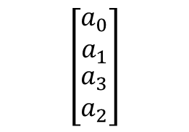

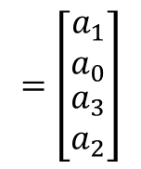

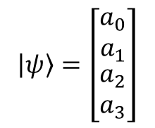

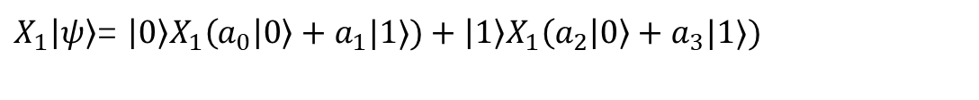


量子线路的模拟方法
$$X=\left|0\right\rangle ⟨1|+|1⟩⟨0|$$
$$\left|ψ\right\rangle =\left[\begin{matrix}a_{0} \\ a_{1} \\ \begin{aligned}a_{2} \\ a_{3}\end{aligned}\end{matrix}\right]$$
$$Y=−i\left|0\right\rangle ⟨1|+i|1⟩⟨0|$$
$$Z=\left|0\right\rangle ⟨0|+|1⟩⟨1|$$
$$\left|ψ\right\rangle =a_{0}\left|00\right\rangle +a_{1}\left|01\right\rangle +a_{2}\left|10\right\rangle +a_{3}\left|11\right\rangle =\left|0\right\rangle \left(a_{0} | 0\right\rangle +a_{1}|1⟩)+\left|1\right\rangle \left(a_{2} | 0\right\rangle +a_{3}|1⟩)$$
$X_{1}\left|ψ\right\rangle$= $\left|0\right\rangle X_{1}\left(a_{0} | 0\right\rangle +a_{1}|1⟩)+\left|1\right\rangle X_{1}\left(a_{2} | 0\right\rangle +a_{3}|1⟩)$
$$\left(\begin{matrix}\left|00\right\rangle \\ \left|01\right\rangle \\ \begin{aligned}\left|10\right\rangle \\ |11⟩\end{aligned}\end{matrix}\right)$$
$$X_{1}$$
= $\left|0\right\rangle \left(a_{2} | 0\right\rangle +a_{1}|1⟩)+\left|1\right\rangle \left(a_{4} | 0\right\rangle +a_{3}|1⟩)$
$$X_{1}$$
$$=\left[\begin{matrix}a_{1} \\ a_{0} \\ \begin{aligned}a_{3} \\ a_{2}\end{aligned}\end{matrix}\right]$$
$$\left[\begin{matrix}a_{0} \\ a_{1} \\ \begin{aligned}a_{3} \\ a_{2}\end{aligned}\end{matrix}\right]$$

Slide 11
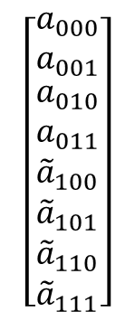


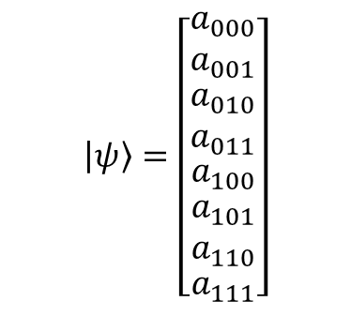
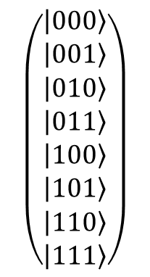
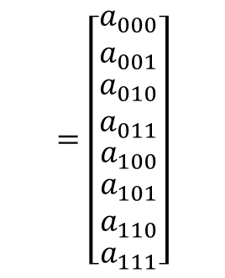

量子线路的模拟方法
$$\left|ψ\right\rangle =\left[\begin{matrix}\begin{matrix}a_{000} \\ a_{001}\end{matrix} \\ \begin{matrix}a_{010} \\ a_{011}\end{matrix} \\ \begin{aligned}\begin{matrix}a_{100} \\ \begin{matrix}a_{101} \\ a_{110}\end{matrix}\end{matrix} \\ a_{111}\end{aligned}\end{matrix}\right]$$
$$CX=\left|0\right\rangle ⟨0|⊗I+\left|1\right\rangle ⟨1|⊗X$$
$${CX}_{31}\left|ψ\right\rangle =\left|0\right\rangle {\left\langle 0\right|}_{3}⊗I_{2}⊗I_{1}+\left|1\right\rangle {\left\langle 1\right|}_{3}⊗I_{2}⊗X_{1}$$
$$=\left[\begin{matrix}\begin{matrix}a_{000} \\ a_{001}\end{matrix} \\ \begin{matrix}a_{010} \\ a_{011}\end{matrix} \\ \begin{aligned}\begin{matrix}a_{100} \\ \begin{matrix}a_{101} \\ a_{110}\end{matrix}\end{matrix} \\ a_{111}\end{aligned}\end{matrix}\right]$$
$$\left[\begin{matrix}\begin{matrix}a_{000} \\ a_{001}\end{matrix} \\ \begin{matrix}a_{010} \\ a_{011}\end{matrix} \\ \begin{aligned}\begin{matrix}{\tilde{a}}_{100} \\ \begin{matrix}{\tilde{a}}_{101} \\ {\tilde{a}}_{110}\end{matrix}\end{matrix} \\ {\tilde{a}}_{111}\end{aligned}\end{matrix}\right]$$
$$\left(\begin{matrix}\begin{aligned}\left|000\right\rangle \\ \left|001\right\rangle \end{aligned} \\ \left|010\right\rangle \\ \begin{aligned}\left|011\right\rangle \\ \left|100\right\rangle \\ \left|101\right\rangle \\ \left|110\right\rangle \\ \left|111\right\rangle \end{aligned}\end{matrix}\right)$$
$${CX}_{31}$$
$${\tilde{a}}_{100}=a_{101}$$

Slide 12



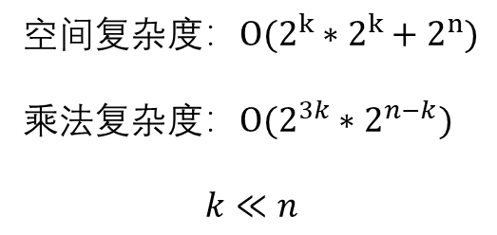
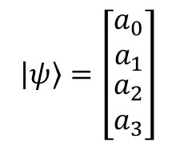
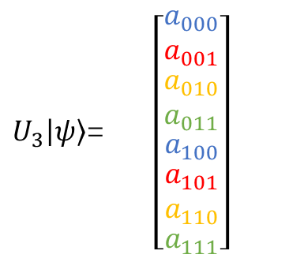




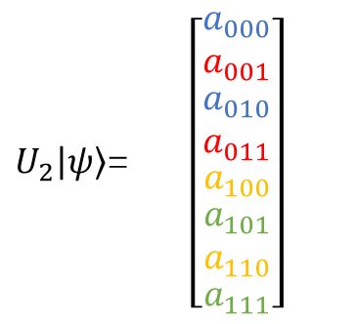


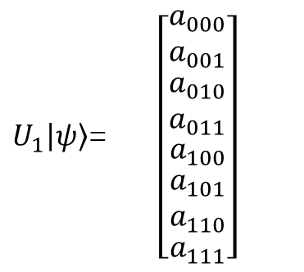

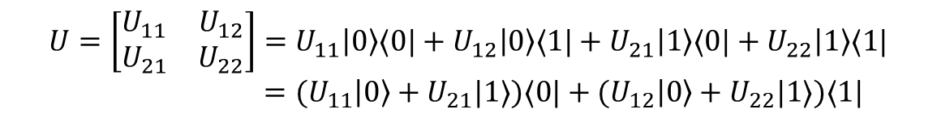







量子线路的模拟方法
$$\left|ψ\right\rangle =\left[\begin{matrix}a_{0} \\ a_{1} \\ \begin{aligned}a_{2} \\ a_{3}\end{aligned}\end{matrix}\right]$$
空间复杂度：$O(2^{k}∗2^{k}+2^{n})$
乘法复杂度：$O(2^{3k}∗2^{n−k})$
$$k≪n$$
$$U=\left[\begin{matrix}U_{11} & U_{12} \\ U_{21} & U_{22}\end{matrix}\right]=U_{11}\left|0\right\rangle ⟨0|+U_{12}\left|0\right\rangle ⟨1|+U_{21}\left|1\right\rangle ⟨0|+U_{22}\left|1\right\rangle ⟨1|$$
$={(U}_{11}\left|0\right\rangle +U_{21}|1⟩)⟨0|+{(U}_{12}\left|0\right\rangle +U_{22}|1⟩)⟨1|$
$$U\left|0\right\rangle ={(U}_{11}\left|0\right\rangle +U_{21}|1⟩)$$
$$U\left|1\right\rangle ={(U}_{12}\left|0\right\rangle +U_{22}|1⟩)$$
$$\left|ψ\right\rangle = \left|0\right\rangle \left(a_{0} | 0\right\rangle +a_{1}|1⟩)+\left|1\right\rangle \left(a_{2} | 0\right\rangle +a_{3}|1⟩)$$
$U_{1}\left|ψ\right\rangle$= $\left[\begin{matrix}\begin{matrix}a_{000} \\ a_{001}\end{matrix} \\ \begin{matrix}a_{010} \\ a_{011}\end{matrix} \\ \begin{aligned}\begin{matrix}a_{100} \\ \begin{matrix}a_{101} \\ a_{110}\end{matrix}\end{matrix} \\ a_{111}\end{aligned}\end{matrix}\right]$
$U_{2}\left|ψ\right\rangle$= $\left[\begin{matrix}\begin{matrix}a_{000} \\ a_{001}\end{matrix} \\ \begin{matrix}a_{010} \\ a_{011}\end{matrix} \\ \begin{aligned}\begin{matrix}a_{100} \\ \begin{matrix}a_{101} \\ a_{110}\end{matrix}\end{matrix} \\ a_{111}\end{aligned}\end{matrix}\right]$
$U_{3}\left|ψ\right\rangle$= $\left[\begin{matrix}\begin{matrix}a_{000} \\ a_{001}\end{matrix} \\ \begin{matrix}a_{010} \\ a_{011}\end{matrix} \\ \begin{aligned}\begin{matrix}a_{100} \\ \begin{matrix}a_{101} \\ a_{110}\end{matrix}\end{matrix} \\ a_{111}\end{aligned}\end{matrix}\right]$
$$U_{1}$$
$$U_{2}$$
$$U_{3}$$
$$\left(\begin{matrix}\left|00\right\rangle \\ \left|01\right\rangle \\ \begin{aligned}\left|10\right\rangle \\ |11⟩\end{aligned}\end{matrix}\right)$$
$$U_{2}$$
$$U_{1}$$
$$U_{1}$$
$$U_{3}$$
$$U_{1}|ψ⟩=$$
$$U_{1}$$
$$U_{1}$$
$$U_{2}$$
$$U_{3}$$
$$U_{1}$$
$$U_{2}$$
$$U_{3}$$

Slide 13






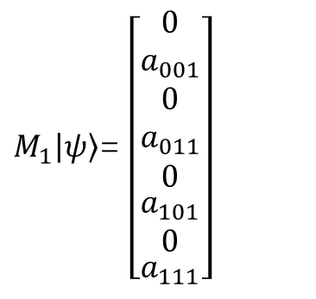

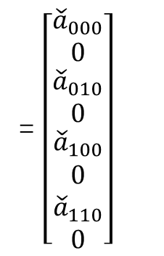



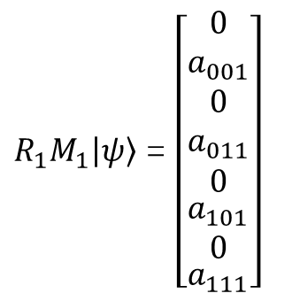
量子线路的模拟方法
中间测量和量子比特复用
$$\left|ψ\right\rangle =\left[\begin{matrix}a_{0} \\ a_{1}\end{matrix}\right]$$
$$\left[\begin{matrix}a_{0/|a_{0}|} \\ 0\end{matrix}\right]$$
$$\left|0\right\rangle p\left(0\right)=a_{0}^{2}$$
$$\left|ψ\right\rangle$$
M
$$\left[\begin{matrix}0 \\ a_{1/|a_{1}|}\end{matrix}\right]$$
$$\left|1\right\rangle p\left(1\right)=a_{1}^{2}$$
量子比特复用(重置为$|0⟩$)
$M_{1}\left|ψ\right\rangle$= $\left[\begin{matrix}\begin{matrix}0 \\ a_{001}\end{matrix} \\ \begin{matrix}0 \\ a_{011}\end{matrix} \\ \begin{aligned}\begin{matrix}0 \\ \begin{matrix}a_{101} \\ 0\end{matrix}\end{matrix} \\ a_{111}\end{aligned}\end{matrix}\right]$
${R_{1}M}_{1}\left|ψ\right\rangle$ = $\left[\begin{matrix}\begin{matrix}0 \\ a_{001}\end{matrix} \\ \begin{matrix}0 \\ a_{011}\end{matrix} \\ \begin{aligned}\begin{matrix}0 \\ \begin{matrix}a_{101} \\ 0\end{matrix}\end{matrix} \\ a_{111}\end{aligned}\end{matrix}\right]$
= $\left[\begin{matrix}\begin{matrix}{\check{a}}_{000} \\ 0\end{matrix} \\ \begin{matrix}{\check{a}}_{010} \\ 0\end{matrix} \\ \begin{aligned}\begin{matrix}{\check{a}}_{100} \\ \begin{matrix}0 \\ {\check{a}}_{110}\end{matrix}\end{matrix} \\ 0\end{aligned}\end{matrix}\right]$
$$\left|ψ\right\rangle$$
M
R
$$\left|0\right\rangle$$
$$\left|1\right\rangle ⇒|0⟩$$
$$R=\left|0\right\rangle ⟨1|$$

Slide 14
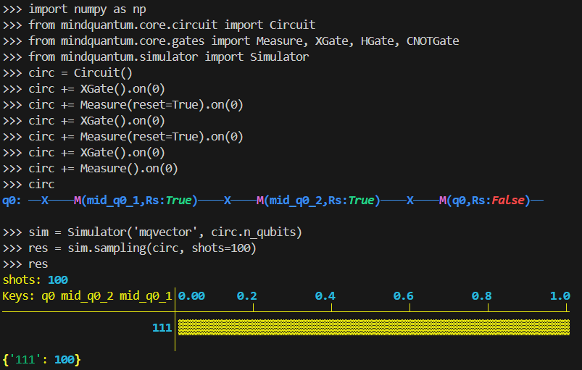
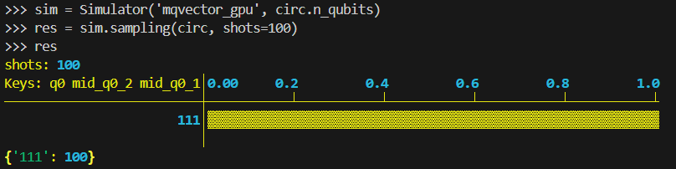
运行示例

Slide 15
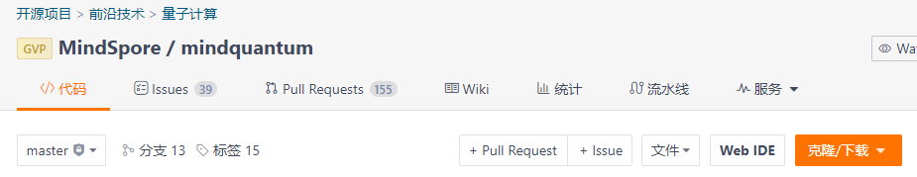
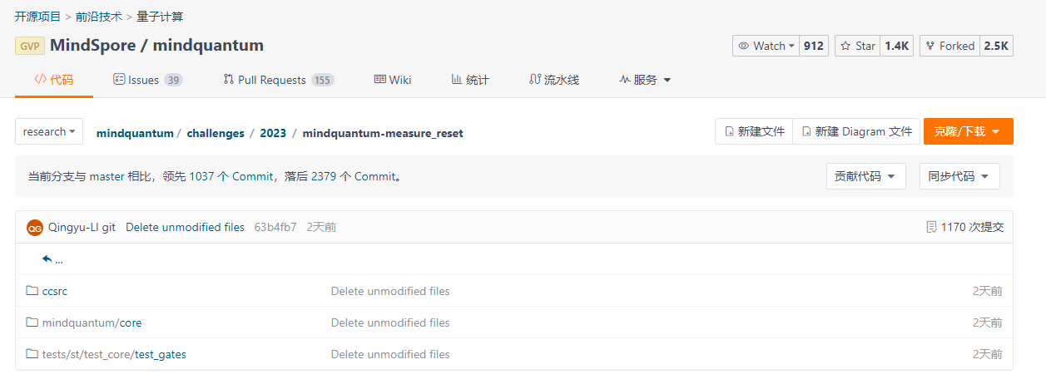
代码仓
替换文件：
源码安装：
https://gitee.com/mindspore/mindquantum

